Slide 1


Slide 2
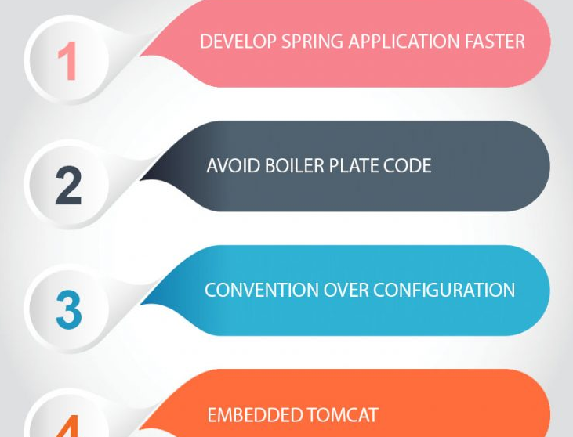
Spring BOOT

Slide 3
Spring BOOT
What is Spring Boot?
Spring Boot is a way by which you can bootstrap or quickly create any Spring application.
Spring Boot makes it easy to create stand-alone, production-grade Spring based Applications that you can “just run”.
Spring Boot helps you create any Spring application in no time. It provides default configurations which help you to avoid a lot of boilerplate code which is painful to maintain.
Spring Boot is a Spring framework module which provides RAD (Rapid Application Development) feature to the Spring framework. It is highly dependent on the starter templates feature which is very powerful and works flawlessly.
Spring BOOT starter template
Spring boot auto configuration
Embedded server
Bootstrap the application.

Slide 4
Spring BOOT
What is Spring Boot Starters?
Spring Boot starters are templates that contain a collection of all the relevant transitive dependencies that are needed to start a particular functionality. For example, If you want to create a Spring WebMVC application then in a traditional setup, you would have included all required dependencies yourself..
Spring Boot offers many starter modules to get started quickly with many of the commonly used technologies, like SpringMVC, JPA, MongoDB, Spring Batch, SpringSecurity, Solr, ElasticSearch, etc. These starters are pre-configured with the most commonly used library dependencies so you don’t have to search for the compatible library versions and configure them manually.
For example, the spring-boot-starter-data-jpa starter module includes all the dependencies required to use Spring Data JPA, along with Hibernate library dependencies, as Hibernate is the most commonly used JPA implementation.
Spring boot autoconfiguration
Autoconfiguration is enabled with @EnableAutoConfiguration annotation. Spring boot auto configuration scans the classpath, finds the libraries in the classpath and then attempt to guess the best configuration for them, and finally configure all such beans.

Slide 5
Spring BOOT
Provide a range of non-functional features that are common to large classes of projects (such as embedded servers, security, metrics, health checks, and externalized configuration).
Spring boot applications always include tomcat as embedded server dependency. It means you can run the Spring boot applications from the command prompt without needling complex server infrastructure.
Bootstrap the application
To run the application, we need to use @SpringBootApplication annotation. Behind the scenes, that’s equivalent to @Configuration, @EnableAutoConfiguration, and @ComponentScan together.
It enables the scanning of config classes, files and load them into spring context. Execution start with main() method. It start loading all the config files, configure them and bootstarp the application based on application properties in application.properties file in /resources folder.

Slide 6
Spring Boot Starter Parent
All Spring Boot projects typically use spring-boot-starter-parent as the parent in pom.xml.
<parent>
<groupId>org.springframework.boot</groupId>
<artifactId>spring-boot-starter-parent</artifactId>
<version>2.0.4.RELEASE</version>
</parent>

Slide 7
Inside Spring Boot Starter Parent
It has spring-boot-dependencies as the parent pom. It inherits dependency management from spring-boot-dependencies.
<parent>
<groupId>org.springframework.boot</groupId>
<artifactId>spring-boot-dependencies</artifactId>
<version>2.0.4.RELEASE</version>
<relativePath>../../spring-boot-dependencies</relativePath>
</parent>
<properties>
<project.reporting.outputEncoding>UTF-8</project.reporting.outputEncoding>
<java.version>1.8</java.version>
<resource.delimiter>@</resource.delimiter>
<maven.compiler.source>${java.version}</maven.compiler.source>
<project.build.sourceEncoding>UTF-8</project.build.sourceEncoding>
<maven.compiler.target>${java.version}</maven.compiler.target>
</properties>

Slide 8
Spring BOOT – Annotations
@SpringBootApplication
@SpringBootApplication annotation indicates a configuration class that declares one or more @Bean methods and also triggers auto-configuration and component scanning.
The @SpringBootApplication annotation is equivalent to using @Configuration, @EnableAutoConfiguration, and @ComponentScan with their default attributes.

Slide 9
Spring BOOT – @EnableAutoConfiguration
@EnableAutoConfiguration annotation tells Spring Boot to “guess” how you want to configure Spring, based on the jar dependencies that you have added. Since spring-boot-starter-web dependency added to classpath leads to configure Tomcat and Spring MVC, the auto-configuration assumes that you are developing a web application and sets up Spring accordingly.
<dependency>
<groupId>org.springframework.boot</groupId>
<artifactId>spring-boot-starter-web</artifactId>
</dependency>

Slide 10


